Slide 1
PRODIGY
Arcade Quiz Engine
Academic Instructor
Dr. Meirav Taieb-Maimon
By Guy Manzurola
Notes:
Prodigy is a game based learning tool for english grammar

Slide 2
Prodigy is a Game Based
E-Learning Tool
What is E-Learning?
Study anytime, at your own pace.
Delivered through digital devices (computer, mobiles etc.)
Cost-effective (no humans involved in teaching, provides automatic feedback)
Accessible

Slide 3
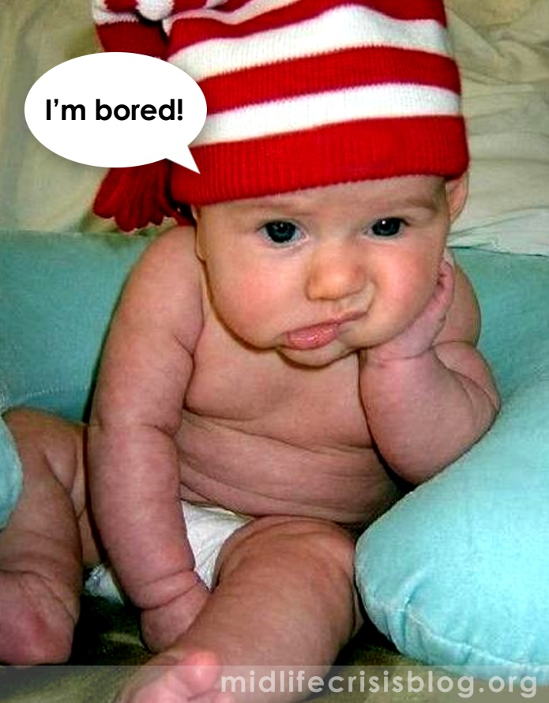
The Problem:
Keeping Learners Motivated
It has always been one of the teacher’s primary roles to motivate students through the learning process.
Motives of a student:
Connection with the learnt
material (rare)
Extrinsic rewards
Intrinsic goals
Fear
Pleasing others
(Prensky, 2002)
Notes:
Problem:
Educators are mainly concerned with getting the material across, to instruct.
Motivation relies on:
-connection with the learnt material (rare)
-extrinsic rewards (get score over x, I’ll buy you a Lego set)
-Intrinsic goals (I want to be able to do Y, so I learn more)
-Fear (If I don’t do it, Z will happen)
-Pleasing others (Teacher will like me if I do this)

Slide 4
The Problem:
Who is the User?
Most existing e-learning solutions focus on the needs of educators rather than fulfilling the needs of the learners themselves.
(Pivec, 2007), (McGinnis, Bustard, Black, & Charles, 2008), (Jong, Shang, Lee, & Law, 2006).
This leaves the learners to find the necessary motivation to study the content themselves.

Slide 5
Why Not Have Some Fun?
It is known that a brain enjoying itself functions more efficiently.
In other words, if we enjoy learning, we learn better.
(Bisso and Luckner, Journal of Experimental Education, 9,2, 1996, pp 109-110.)
(Rose and Nicholl, Accelerated Leaning for the 21st Century, 1998, p. 30.)
(Dr. Frank Moretti, Columbia Teachers College.)
(Knotts and Keys, Simulation and Gaming, 28:4 1997 p. 378)
Notes:
Goal:
Motivating students of esl through various exercises used to practice the structure of the english language (a measure – high completion rate)

Slide 6
Goal
Implement a tool that would make the learning process engaging and motivating for the student.

Slide 7
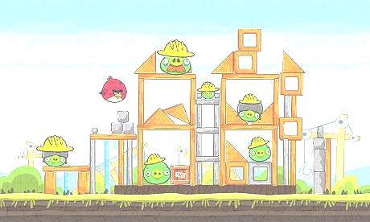
What Makes Things Fun
To Learn?
Characteristics of a Good Game (Malone, 1980):
Challenge
  Goals (performance feedback)
  Uncertain Outcomes (multiple level goals, variable difficulty levels, hidden information, randomness)
  Self Esteem (keep it high)
Fantasy
  Extrinsic Fantasy
  Intrinsic Fantasy
Curiosity
  Sensory (sound and graphics)
  Cognitive (surprising and constructive feedback)
Notes:
Learning and games:
Implement a learning tool using principles from game design.

Slide 8
Heuristics for Creating Fun in Games (Federoff, 2002)
Element | Guideline
Game Interface | A player should always be able to identify their score/status in the game
Game Interface | Use sound to provide meaningful feedback
Game Interface | Provide means for error prevention and recovery through the use of warning messages
Game Interface | Players should be able to save games in different states
Game Mechanics | Feedback should be given immediately to display user control
Game Play | There should be a clear overriding goal of the game presented early
Game Play | There should be variable difficulty level
Game Play | There should be multiple goals on each level
Game Play | Game play should be balanced so that there is no definite way to win
Game Play | The game should give hints, but not too many
Game Play | The game should give rewards
Game Play | There must not be any single optimal winning strategy
Game Play | Design for multiple paths through the game

Slide 9
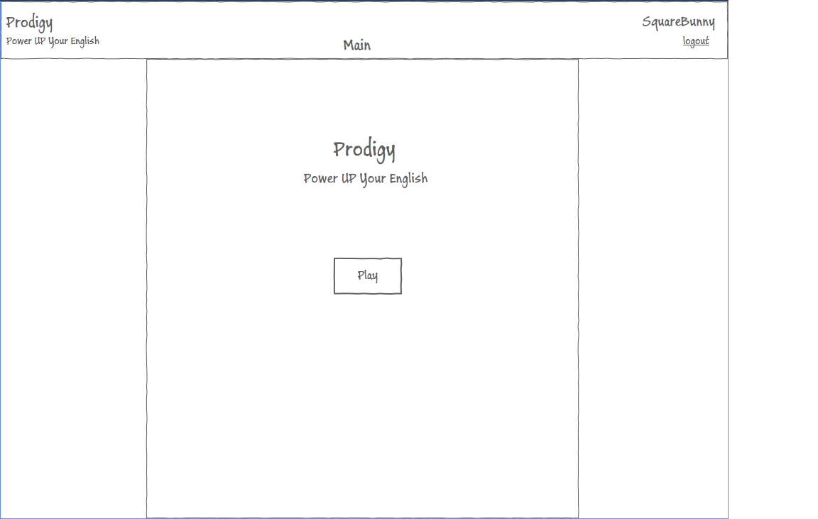
Screen 1 : Main

Slide 10
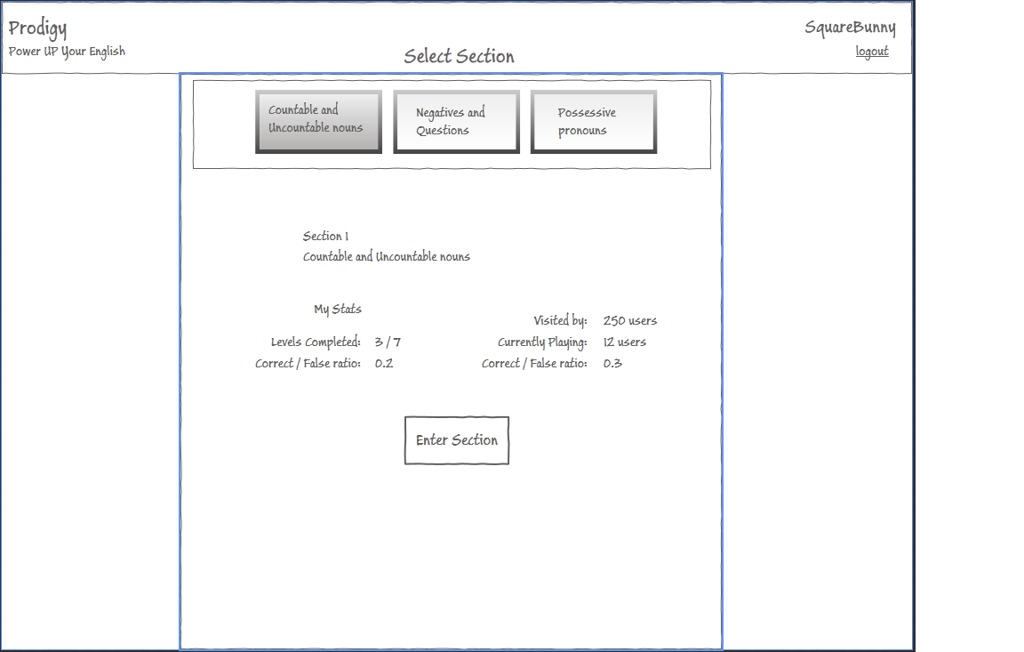
Screen 2 : Select Section

Slide 11
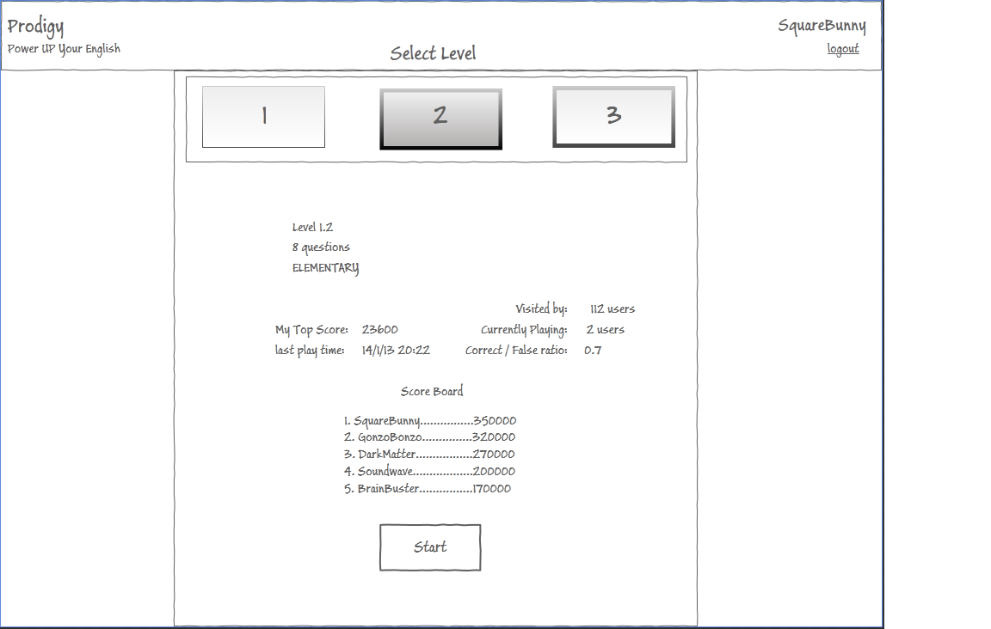
Screen 3 : Select Level

Slide 12
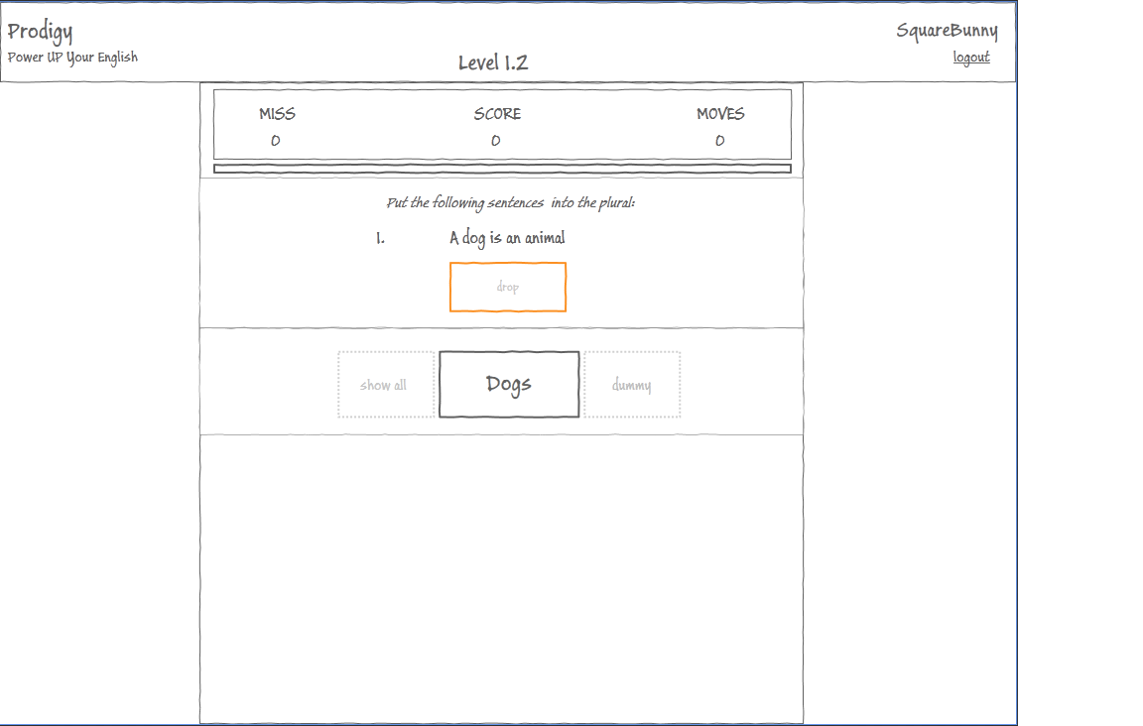
Screen 4 : Level Start

Slide 13
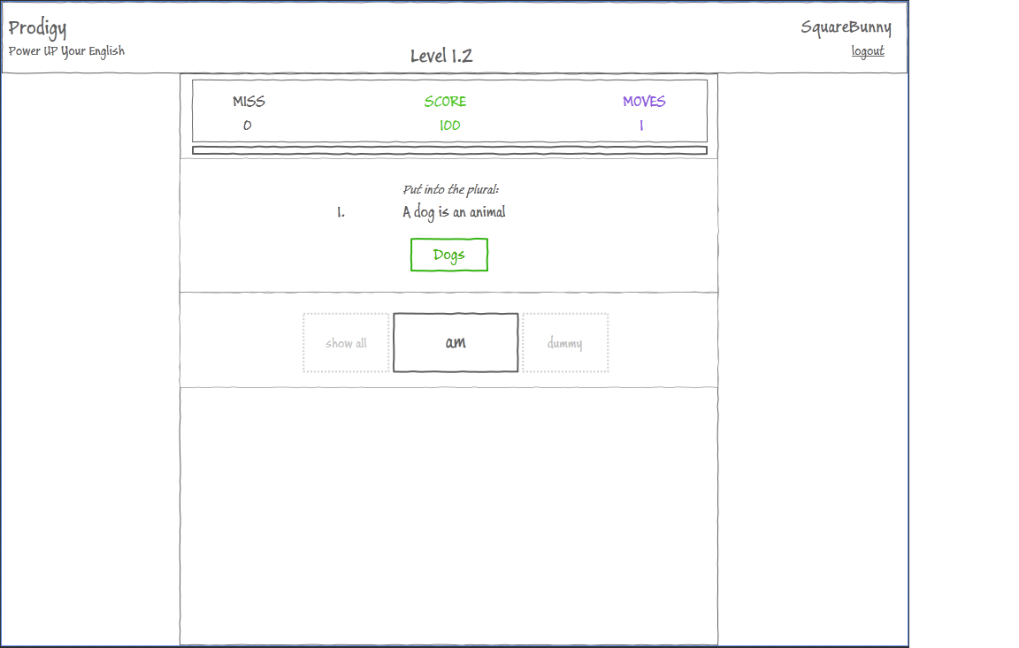
Screen 5 : Correct Choice

Slide 14
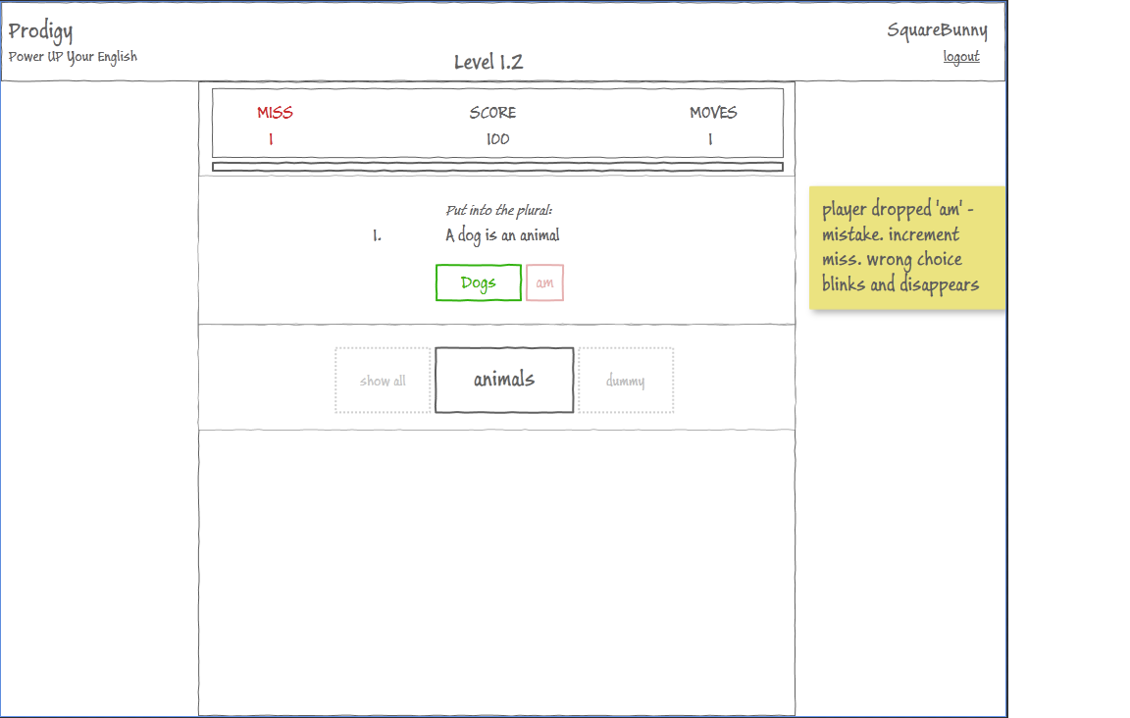
Screen 6 : Wrong Choice

Slide 15
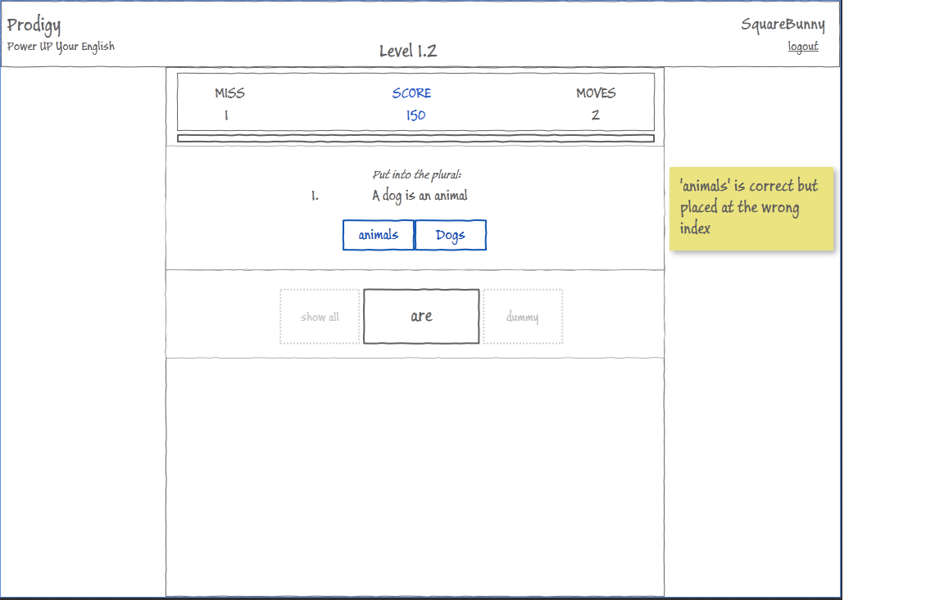
Screen 7 : Correct But Wrong Order

Slide 16
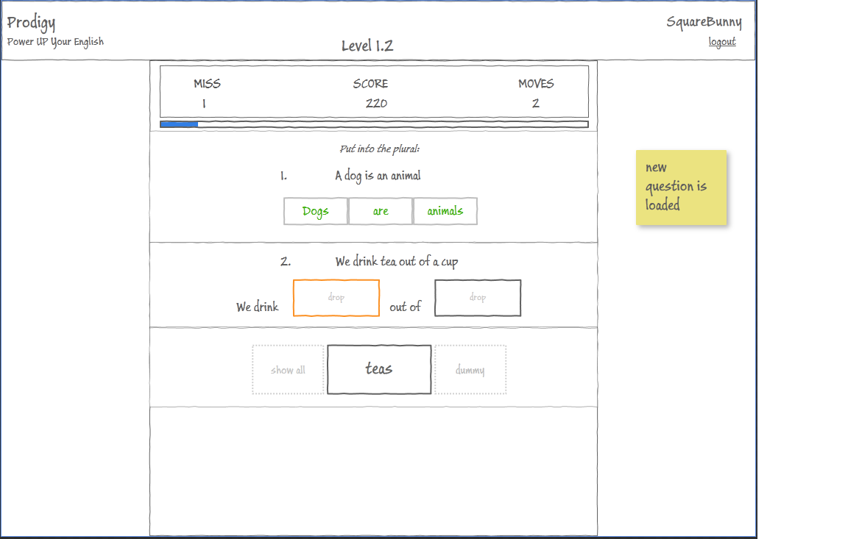
Screen 8 : Question Completed

Slide 17
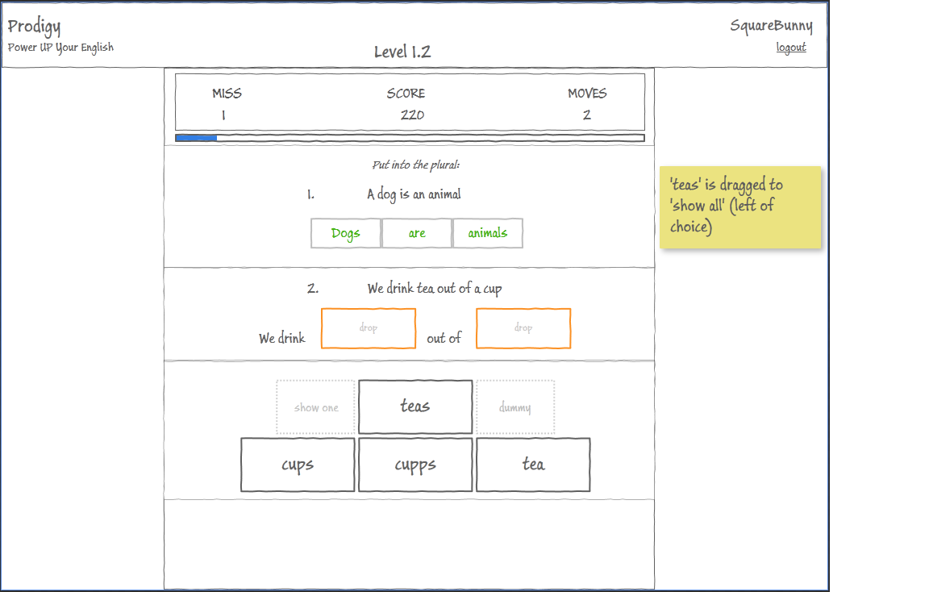
Screen 9 : Show All Choices

Slide 18
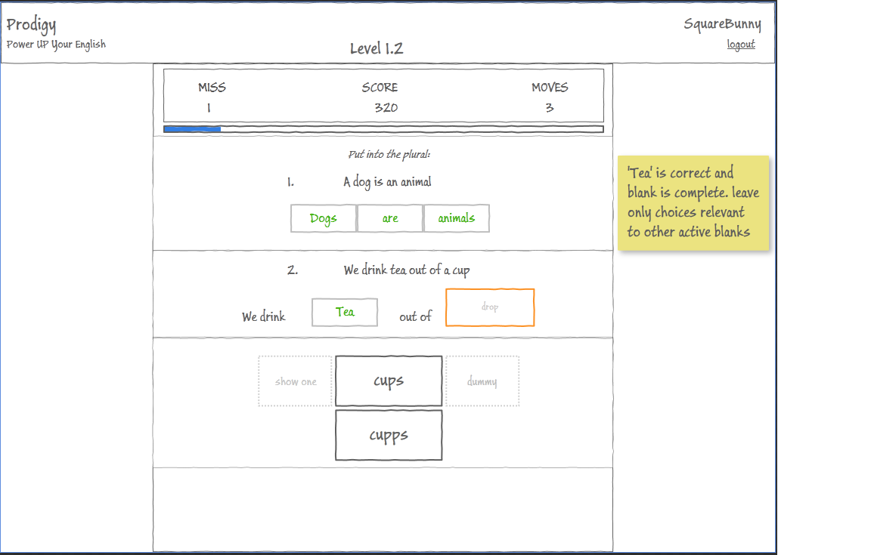
Screen 10 : 1 of 2 Blanks Completed

Slide 19
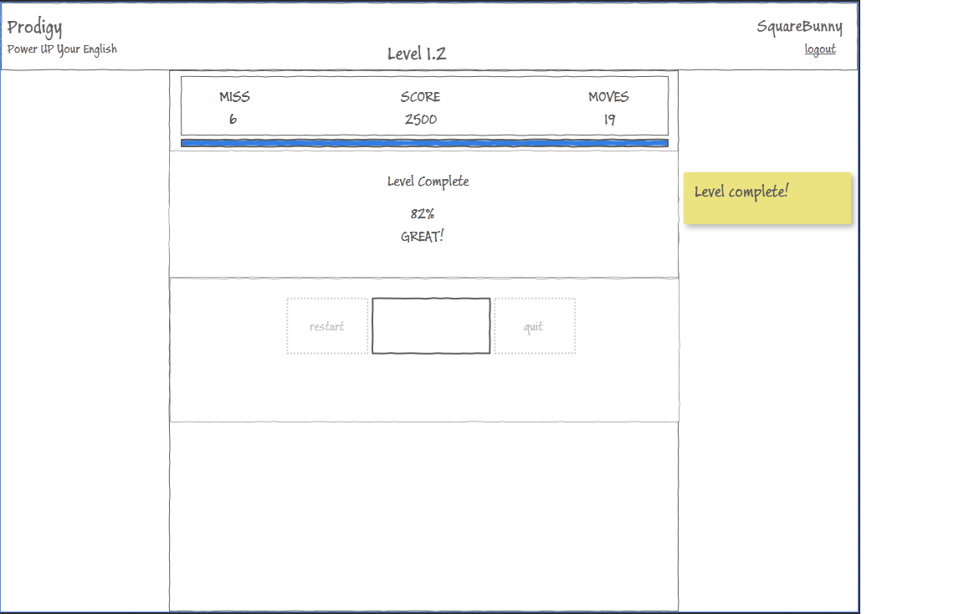
Screen 11 : Level Completed

Slide 20
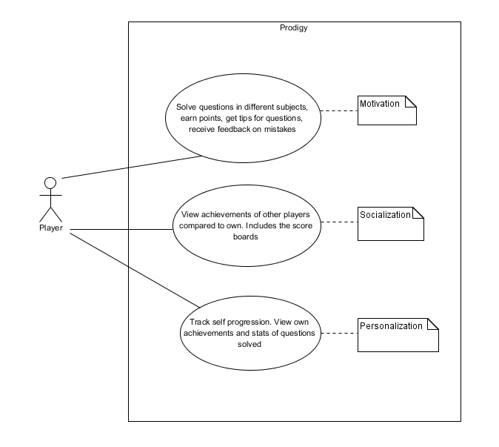
Three Major Use Cases

Slide 21
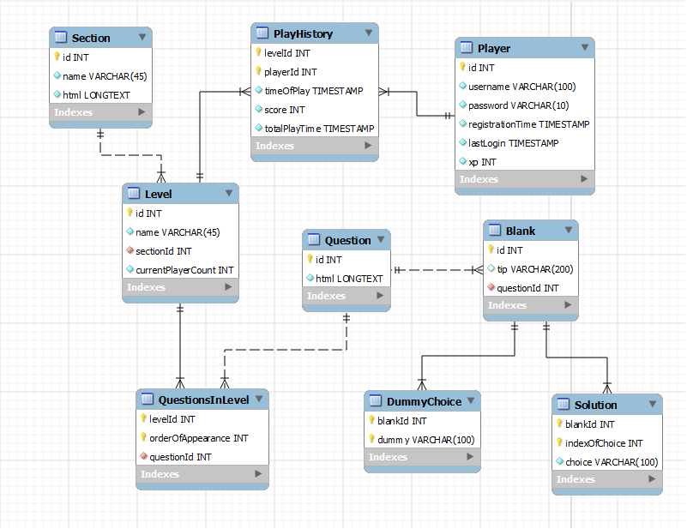
Entity Relationship Diagram

Slide 22
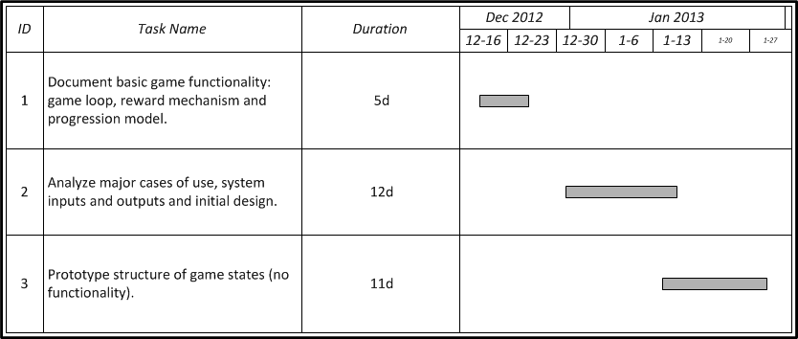
Work Plan

Slide 23
FIN
Good Luck !

